Slide 1



BizNGO 2020
15th Annual Meeting
It looks a little different this year but we’re so happy to have you!

Slide 2

BizNGO 2020 – Day 2
Taking on the challenges to chemical ingredient disclosure (December 9 @ 11am-2pm EST)
Getting ahead of chemical classes (December 9 @ 3-6pm EST)

Slide 3


Thank you to our sponsors!

Slide 4
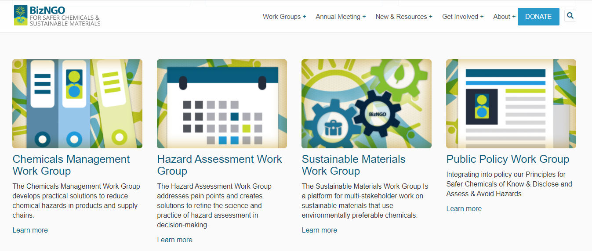

Slide 5

Chatham House Rule
Participants are free to use the information received, but neither the identity nor the affiliation of the speaker(s), nor that of any other participant, may be revealed; unless approved by the participant

Slide 6
Meeting Logistics
Presentations will be recorded
Breakouts, Q&A, & report backs will not be recorded
PPTs will be posted online
If something goes wrong contact
      Kayla 781.391.6743 x120
      Ellen 781.391.6743 x102

Slide 7
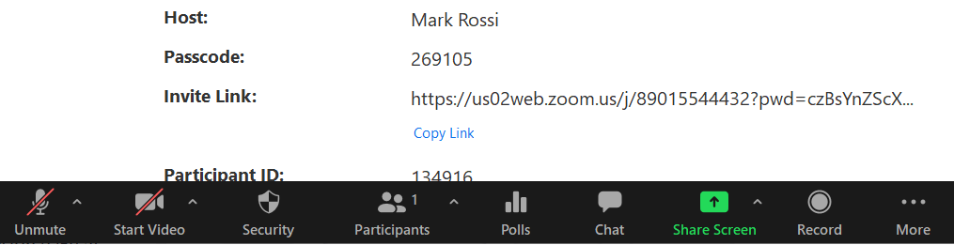

Zoom Protocol
Mute yourself when not speaking
Raise hand to verbally ask a question
Chat questions & comments
Video, feel free to show yourself :)
Rename yourself to include your organization

Slide 8
BizNGO 2020
Session 4
Getting Ahead of Chemical Classes
December 9th 3:00-6:00 pm EST

Slide 9
Session 4 Outcomes
Knowledge of chemical classes and their boundaries
Value proposition of addressing chemicals in classes
Brainstorm list of chemical classes where agreed to definitions and boundaries are needed
Discuss potential role for BizNGO in aligning leadership definitions for priority chemical classes

Slide 10
Session 4 Agenda
Part 1 - Presentations
  3:00 - Introduction
  3:10 - Presentations
  3:50 - Large group Q&A
  4:05 – Reflections
Break: 4:15-4:45 pm EST
Part 2 - Discussions
  4:45 - Guidance to small group break-outs
  4:50 - Small group discussions
  5:15 - Small group report-backs
  5:40 - Large group discussion
  6:00 - Adjourn

Slide 11
Poll #1
Which of the following are priority chemical classes to avoid for you or your organization? (select all that apply)
  Bisphenols
  Alkyl phenols
  PFAS
  Organophosphate Esters (e.g., pesticides, flame retardants)
  Organohalogens
  Flame retardants
  Antimicrobials

Slide 12


Speakers
Linda S. Birnbaum
Scientist Emeritus and Former Director,
NIEHS and NTP
Scholar in Residence, Duke University
Gina M. Solomon, M.D., M.P.H.
Principal Investigator,
Public Health Institute
Clinical Professor, U.C. San Francisco

Slide 13
Getting Ahead of Chemical Classes
Linda S. Birnbaum
Scientist Emeritus and Former Director
NIEHS and NTP
Scholar in Residence, Duke University
BizNGO – December 9, 2020

Slide 14
Tens of Thousands of Chemicals in Commerce
Toxicity Data –
  Any on ~20%
  Adequate on very few
Are Chemicals like people – Innocent until proven guilty?
  Or should Safety be Assessed before marketing?
  Precautionary Principle – act in the presence of concerning information

Slide 15
One Chemical at a Time Approach to Risk or Hazard
Time and resource intensive
Data often limited
Assumption that chemicals with NO data are not hazardous
  “innocent until proven guilty”
Regrettable substitutions
  “Whack a mole”; chemical conveyor belt
Ignoring cumulative risk and under estimation of cumulative risks posed by multiple chemicals

Slide 16
Classic Risk Assessment Paradigm
(NAS Red Book)
Hazard Assessment
  Potential for harm
Exposure Assessment
  Source-→receptor-→ internal exposure
  Biomonitoring
Dose/Response Assessment
  The dose makes the poison
    So does the timing!
Risk Characterization – Putting it all together
Risk management – Policy and Regulations

Slide 17
Class Approach
Common chemical group (e.g., acid)
Similar physical and chemical properties ( e.g., boiling point, lipophilicity)
Effects on similar organs or biological systems (e.g., nervous system)
Similar effect even if different Mode of Action (e.g., hypothyroidism)
Similar effect caused by same mechanism (e.g., anticholinesterase)
Similar Hazard Traits ( e.g., endocrine disruption)
Common uses or Functions (e.g., pesticides)

Slide 18
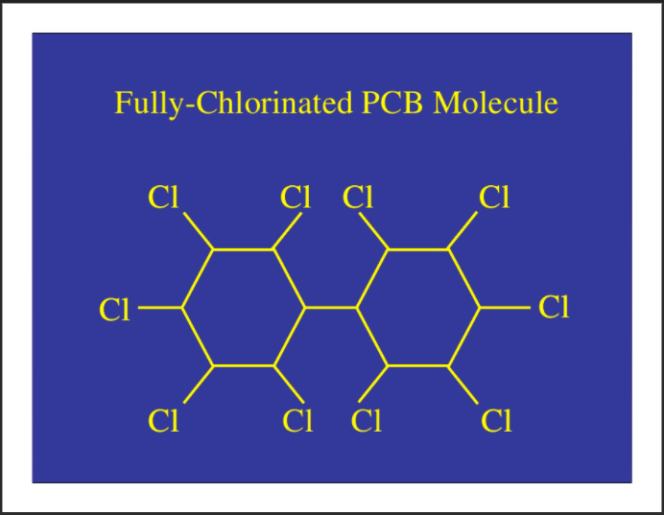
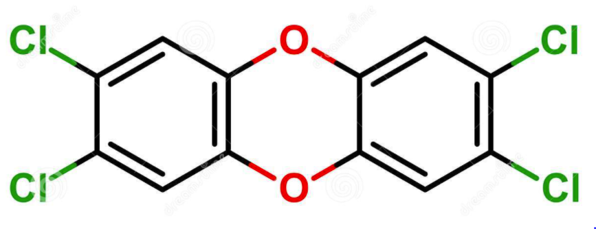
Chemicals Already regulated as a Class
Dioxins
PCBs
TCDD+DL-Dioxins, Furans, PCBs
Common Mechanism (Ah Receptor)
Multiple Mechanisms
  AhR, PXR/SXR, CAR, etc.

Slide 19
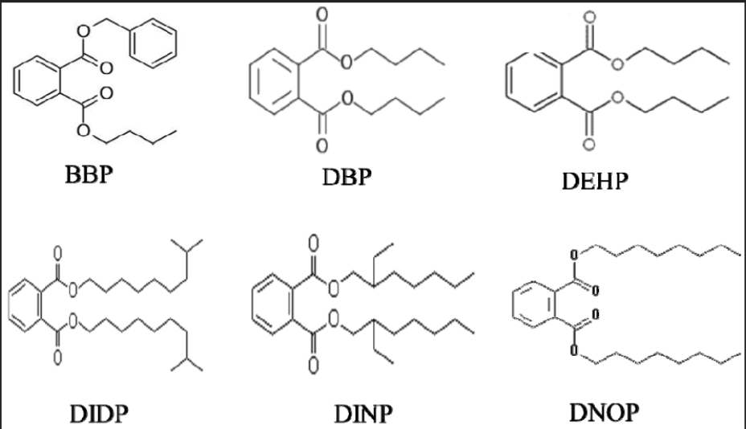
Chemicals Already regulated as a Class (cont.)
PM2.5 Air Pollution
Phthalates
Metals
PAHs
Sulfates
Nitrates
Regulated by Mass
Plasticizers
Several Modes of Action

Slide 20
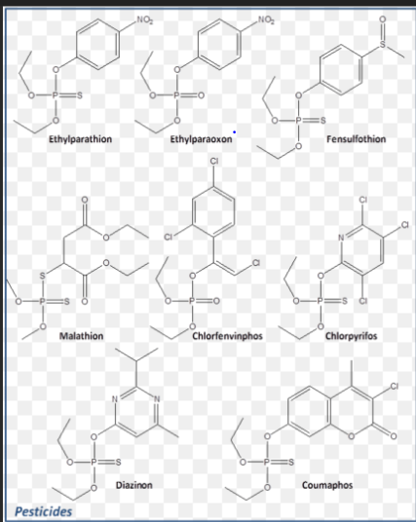
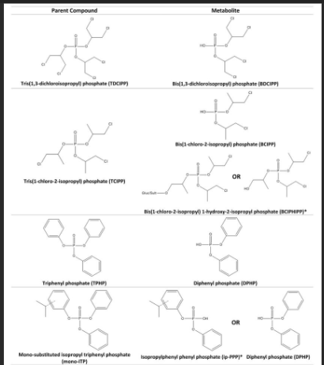
Opportunities to Regulate Chemicals as a Class:
Organophosphate Esters
Anticholinesterase and Developmentally Neurotoxic
OP Pesticides
OP Flame Retardants
OP Plasticizers

Slide 21
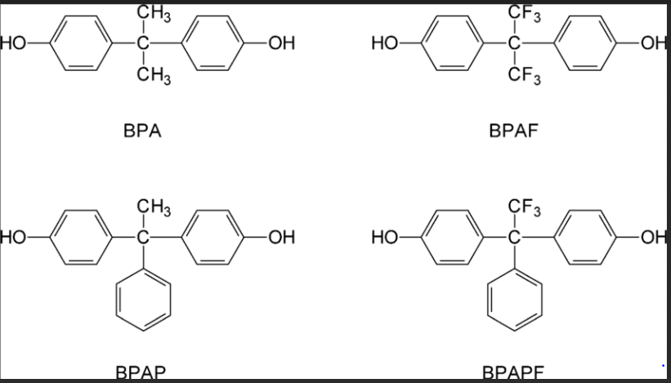
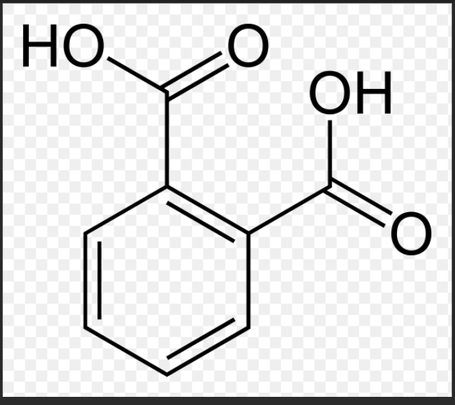
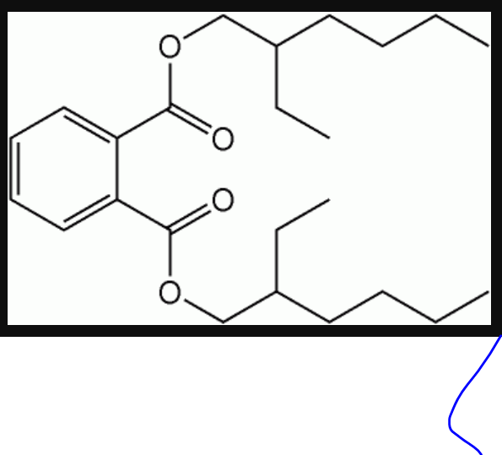
Opportunities to Regulate Chemicals as a Class (cont.)
Bisphenols (“Unfortunate Substitution”)
Low vs. High Molecular Weight Phthalates
Personal care products vs. Plasticizers
PFAS…

Slide 22
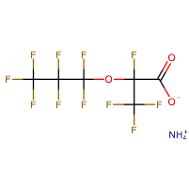
What are Per- and Polyfluoroalkyl Substances (PFAS)?
Total number of PFAS
>9,000 chemicals
  Includes products, impurities and degradants
    Teflon
    Scotchguard
    Aqueous Film Forming Foams (AFFFs)
  Many unknown formulation
Resistant to grease, water & oil
  Surfactants, stain repellants
  Fire suppression - AFFF
Persistent and bioaccumulative
Emergence of short-chain alternatives - less well studied
PFOS
PFOA
PFMOAA
GenX
Notes:
PFOA (C8) used in Teflon
PFOS (C8) in Scotchgard and Gore-Tex
Aqueous fire fighting foam (AFFF) containing PFASs now showing up widely
military installations
Airports
Firefighter training sites

Slide 23
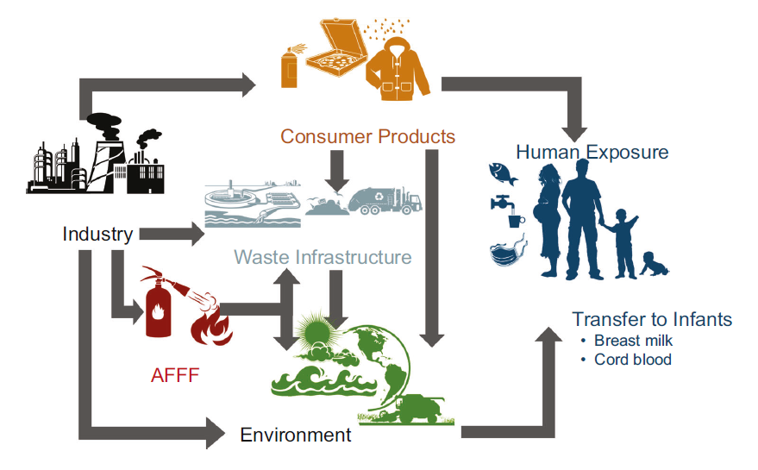
PFAS Exposure
Sunderland et al., J Expos Sci & Epidemiol, 2019
Notes:
With exposures occurring throughout the western human lifestyle, the exposome is also a “System” and must be addressed as such. Breaking one or even a dozen single pathways may reduce but not eliminate exposures.
Acknowledge Elsie Sunderland (Harvard) for this figure (in the audience)
You can use this as a lead in to encourage addressing PFAS as a class such as is underway with CPSC (Consumer Product Safety Commission).
*********
PFAS routes of exposure:
The previous slides highlighted drinking water as a major source of PFAS exposure. And while many of us are familiar with this route of exposure, newer research suggests that air emissions may be one way PFAS reaches our drinking water. PFAS emitted into the air falls back to earth in rainwater, which may be how these chemicals are carried to groundwater miles from the source. In a study conducted by the North Carolina Department of Environmental Quality’s Division of Air Quality, relatively high levels of PFAS were found in rainwater samples up to 20 miles away a chemical plant know to be source of contamination (Chemours - GenX)
But PFAS is in more than our drinking water. We’re also exposed through consumer products such as food contact materials, stain and water-repellent fabrics, nonstick pans, and more.
Image from: Sunderland EM, Hu XC, Dassuncao C, Tokranov AK, Wagner CC, Allen JG. 2019. A review of the pathways of human exposure to poly- and perfluoroalkyl substances (PFAS) and present understanding of health effects. J Expos Sci & Environ Epidemiol 29:131-147.
Affiliation: Department of Environmental Health, Harvard T.H. Chan School of Public Health, Boston, MA, USA.
ABSTRACT: Here, we review present understanding of sources and trends in human exposure to poly- and perfluoroalkyl substances (PFASs) and epidemiologic evidence for impacts on cancer, immune function, metabolic outcomes, and neurodevelopment. More than 4000 PFASs have been manufactured by humans and hundreds have been detected in environmental samples. Direct exposures due to use in products can be quickly phased out by shifts in chemical production but exposures driven by PFAS accumulation in the ocean and marine food chains and contamination of groundwater persist over long timescales. Serum concentrations of legacy PFASs in humans are declining globally but total exposures to newer PFASs and precursor compounds have not been well characterized. Human exposures to legacy PFASs from seafood and drinking water are stable or increasing in many regions, suggesting observed declines reflect phase-outs in legacy PFAS use in consumer products. Many regions globally are continuing to discover PFAS contaminated sites from aqueous film forming foam (AFFF) use, particularly next to airports and military bases. Exposures from food packaging and indoor environments are uncertain due to a rapidly changing chemical landscape where legacy PFASs have been replaced by diverse precursors and custom molecules that are difficult to detect. Multiple studies find significant associations between PFAS exposure and adverse immune outcomes in children. Dyslipidemia is the strongest metabolic outcome associated with PFAS exposure. Evidence for cancer is limited to manufacturing locations with extremely high exposures and insufficient data are available to characterize impacts of PFAS exposures on neurodevelopment. Preliminary evidence suggests significant health effects associated with exposures to emerging PFASs. Lessons learned from legacy PFASs indicate that limited data should not be used as a justification to delay risk mitigation actions for replacement PFASs.

Slide 24

How are we exposed?
[Glϋge et al., Environ Sci: Processes&Impacts, 2020]
Diverse group of chemical compounds used in industry and consumer products worldwide since 1950s
Contaminant in Drinking water
Found in various products:
  Carpet and fabric
  Food paper
  Pots and Pans
  Clothing
  Cardboard packaging
  Firefighting foams (AFFF)
Ingestion (Drinking Water, Food, Dust), Inhalation, Dermal

Slide 25
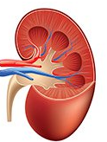

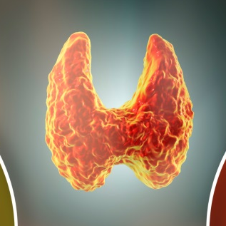






PFAS: Multi-System Toxicants
Kidney
Thyroid
Cancer
Immune
Reproductive
Organs
Liver
Neuro-development
Pancreas
Modified from ATSDR, 2018
Notes:
We’re learning that PFAS have important toxicological effects on many physiological systems. We’ll discuss these effects in depth through this course of the week with plans for plenary sessions and small breakout groups. Encourage the audience to address the multitude of effects from a Systems Perspective.
A major problem we are having addressing PFAS is the tendency for the research community to focus on their favorite effect without considering its role in the pathophysiological system.
Agency for Toxic Substances and Disease Registry (ATSDR). 2018. Toxicological profile for Perfluoroalkyls. (Draft for Public Comment). Atlanta, GA: U.S. Department of Health and Human Services, Public Health Service. https://www.atsdr.cdc.gov/toxprofiles/tp.asp?id=1117&tid=237
*******
Slide to provide high-level summary/overview of PFAS health effects for outcomes where we have sufficient evidence.
PFAS affect multiple tissues in both males and females and at all life stages:
Thyroid, Liver, Pancreas: Laboratory animals exposed to one or more of these PFAS have shown changes in liver, thyroid, and pancreatic function.
Thyroid: Some PFAS alter thyroid hormone homeostasis that regulates metabolism and growth – (may manifest differently in humans vs rodents; TSH humans, T4 rodents)
Pancreas & Liver: Interferes with metabolism; for example, PFAS exposure may contribute to altered insulin resistance and glucose tolerance, overweight, steatosis, altered lipid homeostasis
Immune system: reduced immune function (suppressed antibody response)
Kidneys: altered glomerular filtration rates, chronic kidney disease, cancer
Reproductive Organs: Associated with decreased fertility, gestational hypertension, decreased breastfeeding ability or duration, and testicular cancer
Neurodevelopment: Affects learning and behavior of infants and older children
Many of associations seen in humans are supported by animal testing, in vivo, in vitro models, and structural activity relationships.
Take-home message: These chemicals are biologically active and adversely affecting human health. And many of the health effects seen in humans are supported by animal, in vivo, and in vitro models.

Slide 26
Key Research Questions
Total organic fluorine analysis – Are we measuring 90% or 10% of PFAS present in a sample?
Essentiality – Where are chemicals really needed and where can we replace with safer alternatives? (Cousins et al., 2019)
Assessing alternatives – Are our substitutes safer?
PFAS as a class – One chemical group or subclasses? Too many PFAS to do proper toxicity testing (including mixtures)
  The National Academy of Sciences, Engineering, and Medicine (NASEM) recently addressed hazards to Organo-Halogen Flame retardants in a report to the Consumer Product Safety Commission (CPSC – 7/24/2019).
    NASEM strongly endorsed the use of subclasses of organohalogens in hazard assessment along with the use of alternative toxicological approaches.
  Regulate PFAS as A Class ((Kwiatkowski et al., ES&T Lett. 2020)
  Regulate PFAS as Subclasses (Cousins et al., Env. Sci, Processes&Impacts, 2020)
Notes:
Here are some challenges to the audience…….
Solve
The Essentiality scheme, which is described in a paper published in Environmental Science: Processes & Impacts in , assigns substances to one of three categories:
category 1 non-essential, the substance fulfils functions that might be considered ‘nice to have’;
category 2 substitutable, it fulfils important functions but viable alternatives exist; and
category 3 essential.
For example, their use in cosmetics could be category 1 and their use in membranes necessary for high-tech processes could be category 3.
Reference: Cousins et al. The concept of essential use for determining when uses of PFASs can be phased out, Environmental Science: Processes & Impacts: May 2019.
Affiliation: Department of Environmental Science and Analytical Chemistry (ACES), Stockholm University, SE-10691, Sweden
DOI:10.1039/C9EM00163H
https://pubs.rsc.org/en/content/articlehtml/2019/em/c9em00163h?page=search
Because of the extreme persistence of per- and polyfluoroalkyl substances (PFASs) and their associated risks, the Madrid Statement argues for stopping their use where they are deemed not essential or when safer alternatives exist. To determine when uses of PFASs have an essential function in modern society, and when they do not, is not an easy task. Here, we: (1) develop the concept of “essential use” based on an existing approach described in the Montreal Protocol, (2) apply the concept to various uses of PFASs to determine the feasibility of elimination or substitution of PFASs in each use category, and (3) outline the challenges for phasing out uses of PFASs in society. In brief, we developed three distinct categories to describe the different levels of essentiality of individual uses. A phase-out of many uses of PFASs can be implemented because they are not necessary for the betterment of society in terms of health and safety, or because functional alternatives are currently available that can be substituted into these products or applications. Some specific uses of PFASs would be considered essential because they provide for vital functions and are currently without established alternatives. However, this essentiality should not be considered as permanent; rather, constant efforts are needed to search for alternatives. We provide a description of several ongoing uses of PFASs and discuss whether these uses are essential or non-essential according to the three essentiality categories. It is not possible to describe each use case of PFASs in detail in this single article. For follow-up work, we suggest further refining the assessment of the use cases of PFASs covered here, where necessary, and expanding the application of this concept to all other uses of PFASs. The concept of essential use can also be applied in the management of other chemicals, or groups of chemicals, of concern.

Slide 27


THANK YOU!!!

Slide 28
Chemical Classes: Concepts from The National Academy of Sciences and Biomonitoring California
Gina M. Solomon, M.D., M.P.H.
Principal Investigator, Public Health Institute
Clinical Professor, U.C. San Francisco

Slide 29
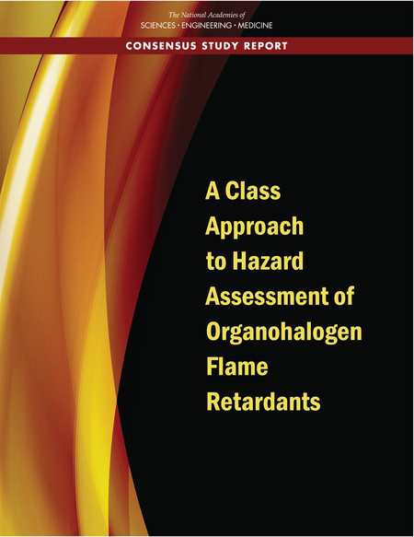
National Academy of Sciences on Chemical Classes
Released in June 2019
Committee formed at the request of the Consumer Product Safety Commission (CPSC)
Triggered by an NGO petition

Slide 30




Committee Findings
Evaluating one chemical at a time has problems:
Chemicals with insufficient data are often considered not hazardous
Untested chemicals are often substituted for known hazardous chemicals
Cumulative exposure and risk are often ignored
“Ultimately, the sheer number of chemicals in use today demands a new approach to risk assessment.”
The report emphasizes that these findings are consistent with multiple prior NAS reports:

Slide 31
A Class Approach
“The committee concluded that a science-based class approach does not necessarily require one to evaluate a large chemical group as a single entity for hazard assessment…an approach that divides a large group into smaller units (or subclasses) … is still a class approach.”
Report p. 8

Slide 32
Strategy for Defining Sub-Classes
“The Committee….concluded that the best approach is to define subclasses as broadly as is feasible for the analysis; defining subclasses too narrowly could defeat the purpose of a class approach to hazard assessment.”
Report p. 2

Slide 33
Define Sub-Classes
Grouped the OFR inventory on the basis of predicted biologic activity (such as GABA receptors, aromatase activity, and ER/AR modulators); 8 biology-informed categories identified.
Merged structural and biological information.
14 biological/structural subclasses, containing 4-22 members.
Some chemicals in more than one class.
Major top-level chemotypes present in the OFR seed set

Slide 34
14 Organohalogen Flame Retardant Sub-Classes

Slide 35
Two Case Studies
Polyhalogenated organophosphates (OPs)
Polyhalogenated bisphenol aliphatics

Slide 36

Case Studies
Performed literature search and data extraction, including traditional toxicology, Zebrafish data; ToxCast/Tox21 data.
Focused on developmental toxicity and thyroid homeostasis.
Evaluated and integrated data.
Result: “The available data are too heterogeneous or inconsistent on biologic activity.”
Conclusion: Discordant data.

Slide 37
What to Do if Discordant?
Option 1: Make a policy decision, for example, to extend the most conservative conclusion regarding hazard to the subclass.
Option 2: Reclassify members to improve their biologic similarity; generate data to increase confidence that reclassification has resulted in biologically similar members.
Option 3: Perform analyses to explain the discordance and allow the assessment to move forward.
Option 4: Generate new data that could increase clarity and the scientific basis for a decision.

Slide 38


Biomonitoring California
“California’s Environmental Contaminant Biomonitoring Program developed a process for defining chemical classes that combined structure and functional use (Krowech et al. 2016). That approach was adopted by the California Safer Consumer Products Program (DTSC 2013)”

Slide 39
Conclusions
A class approach to chemicals is scientifically justifiable in all decision contexts, but the approach to forming classes may differ.
In a risk assessment context, classes should be based on a combination of chemistry and predicted biology.
If the available data are relatively concordant, it is scientifically justifiable to extrapolate to class members that do not have data.
Predictive toxicology can be useful for establishing classes and supporting extrapolations across classes.
Discordant data within classes is a challenge that will require additional investigation.

Slide 40
Thank you!

Slide 41
Questions?
Use the chat to type in a question or comment
Raise your hand if you would like to speak

Slide 42
Questions?
Raise hand or Chat
Linda S. Birnbaum
Scientist Emeritus and Former Director,
NIEHS and NTP
Scholar in Residence, Duke University
Gina M. Solomon, M.D., M.P.H.
Principal Investigator,
Public Health Institute
Clinical Professor, U.C. San Francisco

Slide 43

Reflections
Dr. Holly Davies
Senior Toxicologist,
Washington State Department of Health

Slide 44
BizNGO 2020
Sesssion 4 - BREAK
4:15 – 4:45 EST

Slide 45
Discussion Agenda
4:45 pm ET: Guidance to small group break-outs
4:50 pm ET: Small group discussions
5:15 pm ET: Small group report-backs
5:40 pm ET: Large group discussion
5:55 pm ET: Next Steps
6:00 pm ET: Adjourn

Slide 46
Small Group Logistics
You will have 20-25 minutes
Select a spokesperson to report back
Select a note taker
Discuss questions provided
  Provided on the next slide and in Google document (link below)
  https://docs.google.com/document/d/1Iyijwik-LYgrk9aYBxqaGcrYOt5AtQtih1I93EPlFbE/edit?usp=sharing
Take notes on your discussion
  Put them in Google document
  Can take them directly into Google document or into a separate Word document and then paste them into the Google document at the end of small group
You will have 2-3 minutes to report back

Slide 47
Small Group Discussion Questions
Your small group’s priority chemical classes?
How are you defining chemical classes and their boundaries?
Are you specifying chemicals by CASRN within a class? If not, how do you implement the class?
Resources you turn to specify chemical classes?
Role for BizNGO?

Slide 48
Poll #1
Which of the following are priority chemical classes to avoid for you or your organization? (select all that apply)
  Bisphenols
  Alkyl phenols
  PFAS
  Organophosphate Esters (e.g., pesticides, flame retardants)
  Organohalogens
  Flame retardants
  Antimicrobials

Slide 49
Small Group Report Back
Group 1
Priorities: PFAS, heavy metals, antimicrobials, FRs, Ops, pesticides, orthophthalates
Defining: some not there yet, starting with certification lists with CASRN and recognizing may not be all inclusive; if you are a manufacturer you might not need a list of CASRN for a banned group but if dealing with something already manufactured e.g., you are an assembler then it is important to get CASRN to have something to check against
Role for BizNGO: Conversations like this

Slide 50
Small Group Report Back
Group 2
Priorities: PFAS, FRs, plasticizers, GHG, OP pesticides, VOCs
Defining: PFAS – OECD definition and EU definition that is broader and which one to use; source reduction with retailers focus on essential and non-essential uses; byproducts for manufacturing is a huge issue in electronics; polymers in PFAS … often don’t have CASRN for reactive polymers, helps to have CASRN to figure out what is in the class or need technical folks to look at structures and see if it fits in the definition. Lists are not static so need info on when and how often list is going to be updated.

Slide 51
Small Group Report Back
Group 3
Priorities: all chemicals in the prior poll; PFAS and bisphenols, phthalates, FRs, APEs
Defining: PFAS easy b/c of total fluorine analytical method; difficult to regulate b/c no common mechanism; DTSC rely on other lists to define the classes e.g., Biomonitoring CA
Specify by CASRN? Helpful to get correct and consistent results in some cases; regulatory can use definition
BizNGO? Prioritizing classes of concern, identifying where chemicals in a class are found, more engagement with food packaging manufactureres; leadership definition for classes

Slide 52
Small Group Report Back
Group 4
Priority
Personal care: priority chemicals fall under known bad players defined/guided by regulatory considerations primarily in EU; consumer advocacy groups
UV filters, formaldehyde donors, fragrance, etc.
Use of CASRN is helpful, but not all chemical is assigned a CASRN I
Resources: authoritative lists, Pharos, Toxnot
BizNGO: Help build customer awareness and need for chemical classes and concerns around the classes;
hard to find publicly available data to make these determinations
Retailers can say no to certain chemicals and create chemical classes; don’t need the same type of definition as required in a regulatory context
BizNGO: create information that is consumer friendly (not so technical)

Slide 53
Small Group Report Back
Group 5
PFAS was at the top of the priority list
Consultant class priorities are client driven
Needs to be a defined list for some of these classes in order to verify products
Standardization of these classes from decision-making perspective would be helpful; lots of clients don’t know what they should be looking for
Extremes: broad classes with minimal definition and then very specific 1 chemical; may need some middle ground
Difference in class-based approach from assessment vs. decision-making perspective (often used in assessment perspective to fill data gaps)
Sub-class approach might be best for PFAS

Slide 54
Small Group Report Back
Group 6
Not dealing with classes yet or are struggling with them
Carbon nanotubes and nanofibers
Need for CASRN to communicate up and down supply chain and send clear signals
Problematic materials e.g., plastics with additives and process chemicals
BizNGO? Provide lists with CASRN and class,
Depends what you use the list for … watch list vs. restricted/banned (needs more well defined)
Proprietary info would be easier if you did classes – companies said no.

Slide 55
Small Group Report Back
Group 7
Endocrine disruptors also as priority
Define with chemical characteristics, functional characteristics, persistence, essentiality
Balance of wanting to use a larger group (guilty until proven innocent)
Detection methodology for a class
CASRN helps be more clear with industry
Resources: Authoritative list of lists, GSPI six classes, REACH related substances,
Role for BizNGO: define classes in the context the class would be useful; help to group chemicals from authoritative lists into useful classes

Slide 56
Bold BizNGO Goal for 2021:
Stakeholders Agree to Chemical Classes
Proposal: Business, NGO, and government leaders develop leadership position in defining and specifying chemical classes with the goal of eliminating these chemical classes in products and manufacturing. In 2021, BizNGO will seek to gain alignment to 3-7 chemical classes.
Alignment involves agreeing to:
  Definition of the chemical class, which involves specifying the boundaries of the class, e.g., physical-chemical properties, toxicity, fate, and/or function
  Specification of the chemicals in that class given the definition and boundaries of the class
Organizations/individuals sign on in support of using the definitions in their work.

Slide 57
Poll #2
Q1. How important do you think it is for leadership organizations to align on definitions of chemical classes?
  Extremely important
  Very important
  Important
  Marginally Important
  ·Not important
Q2: Would you be supportive of BizNGO playing a role in the alignment of chemical classes?
  Extremely supportive
  Very supportive
  Supportive
  Marginally Supportive
  Not supportive

Slide 58
THANK YOU!
Thank you for joining! Today’s presentations and slides will be made available at www.bizngo.org.
Please fill out the evaluation form for this session!
https://forms.gle/KRfp1zMZ26JKSKL17

