Slide 1
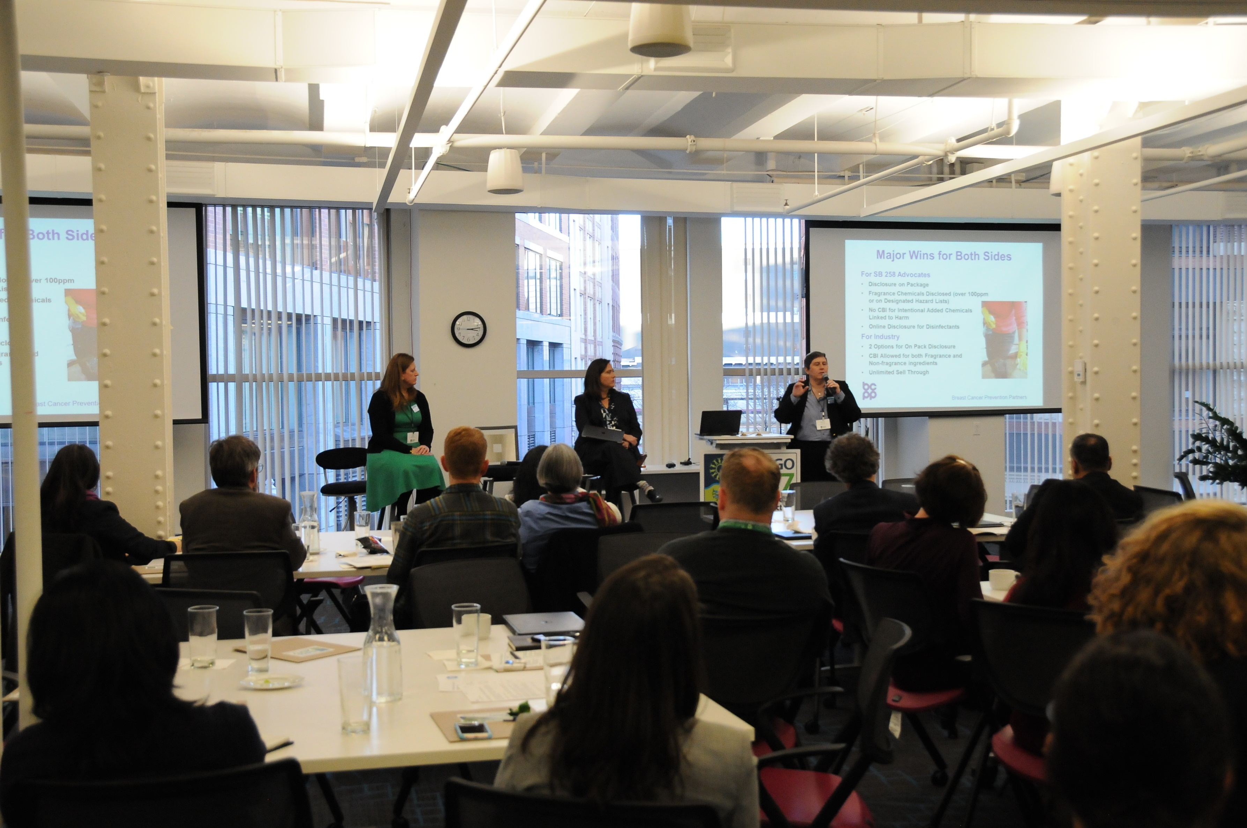


BizNGO 2020
15th Annual Meeting
It looks a little different this year but we’re so happy to have you!

Slide 2

banning the most harmful chemicals in consumer products
phasing out PFAS unless their use is essential
boosting the investment and innovative capacity for production and use of chemicals that are safe and sustainable by design, and throughout their life cycle
establishing a simpler “one substance one assessment” process for the risk and hazard assessment of chemicals

Slide 3
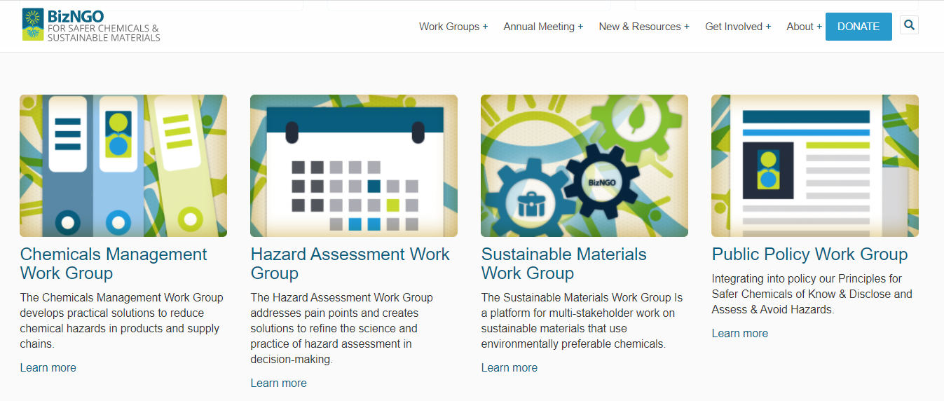

Slide 4

Virtual Meeting Overview
4 Sessions / 2 days
Each session 3.0 hrs divided into 2 parts of 1.25 hrs with 0.5 hr break
Confronting diversity, equity, and inclusion (DEI) at the intersection of business and hazardous chemicals (today @ 11am-2pm EST)
Measuring & disclosing chemical footprints (today @ 3-6pm EST)
Taking on the challenges to chemical ingredient disclosure (December 9 @ 11am-2pm EST)
Getting ahead of chemical classes (December 9 @ 3-6pm EST)

Slide 5


Thank you to our sponsors!

Slide 6

Chatham House Rule
Participants are free to use the information received, but neither the identity nor the affiliation of the speaker(s), nor that of any other participant, may be revealed; unless approved by the participant

Slide 7
Session 1
Confronting diversity, equity, and inclusion (DEI) at the intersection of business and hazardous chemicals

Slide 8
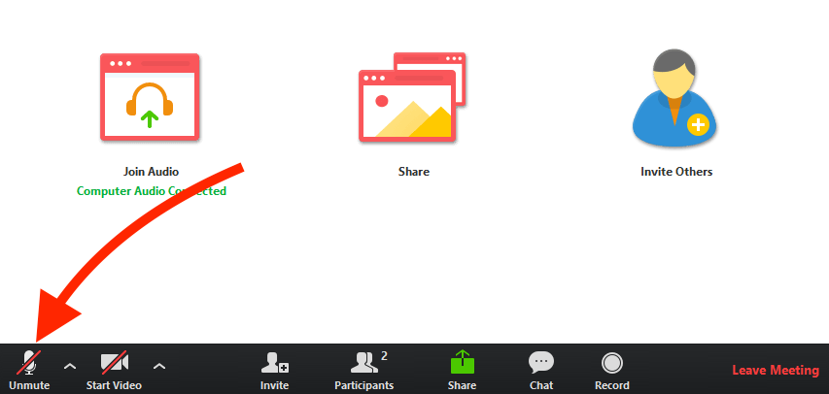
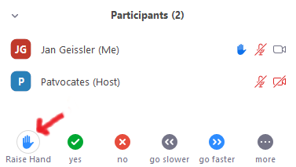
Zoom Protocol
Mute yourself when not speaking
Raise hand to verbally ask a question
Chat questions & comments
Feel free to show your video :)
Enter participant ID if calling in
Rename yourself to include your organization

Slide 9
Session 1 Desired Outcomes
Recognized and acknowledged need to address DEI in BizNGO
Meaningful and engaging sharing of ideas
Learned best/better practices in DEI in the context of chemicals
  Exploring pathways for BizNGO to amplify these practices
  Resource sharing
Brainstormed goals for BizNGO on DEI and environmental justice
Inspired to take action

Slide 10
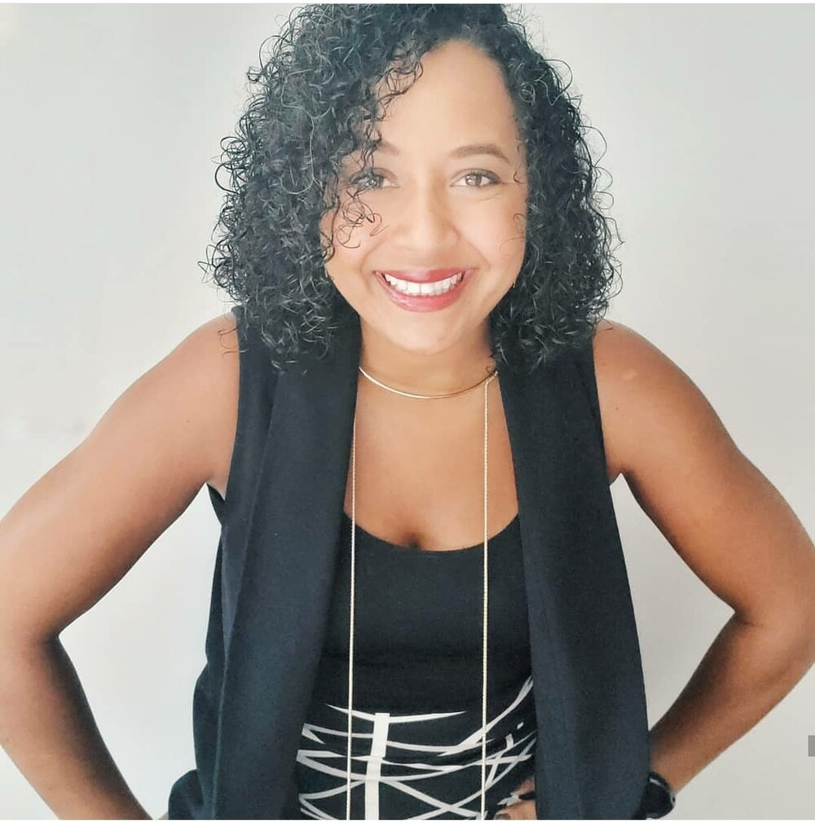
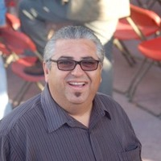
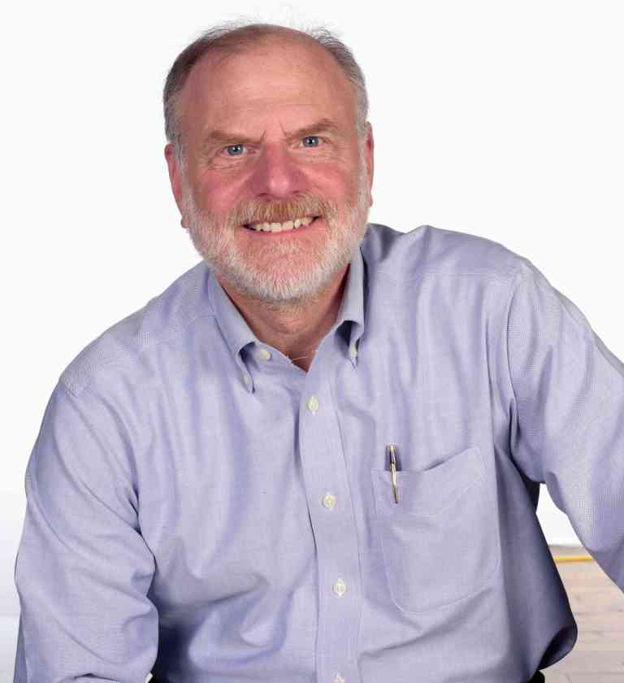
Speakers
Hannah McCall
Founder, Clean Beauty for Black Girls
José Bravo
Executive Director, Just Transition Alliance;
National Coordinator, Dollar Store Campaign
Martin Wolf
Director of Sustainability & Authenticity, DEI Committee Member; Seventh Generation

Slide 11
Session 1 Agenda
11:10 Session Introduction : Confronting diversity, equity and inclusion at the intersection of business and hazardous chemicals (Kayla—10 minutes)
11:20 Featured speaker (20 minutes)—Hannah McCall (Clean Beauty for Black Girls; has a podcast)
11:40 Environmental Justice Presentation (20 minutes) – Jose Bravo (Just Transitions/Dollar Store Campaign)
12:00 Q&A
12:15 Break
12:45 Reflections from Part 1 (10 minutes) – Kayla
12:55 Breakout rooms
Questions:
    Where are these conversations (intersection hazard/toxics + DEI + EJ) happening at your organization or business?
    What is your organization doing to take an effective approach to your work through a DEI + EJ lens?
    What do you think BizNGO could be doing? Is the workgroup well positioned to do that right now?
    What conversations does BizNGO need to have in 2021? What are some tangible outcomes we can aim for in 2021?
1:15 Report Backs &
Panel Reactions/Responses
    Facilitator: Kayla
    Panelists: Hannah McCall (Founder, Clean Beauty for Black Girls), Jose Bravo ( National Coordinator, Dollar Store Campaign; Executive Director, Just Transition Alliance), Marquis Denson (JEDI Committee Member, Seventh Generation).
1:55 Close – Kayla
2:00 Adjourn

Slide 12
Diversity, Equity and Inclusion at
Clean Production Action
Foster organizational alignment around the terms diversity, equity and inclusion
Begin shifting the narrative about how we think about our work, its impacts, and alignment to DEI concepts + values and how that is communicated to the world
Train staff
Establish core DEI committee

Slide 13
Defining the Terms
Diversity - A measure of the dimensions of the difference or similarity that exist within a group taking into account national origins, languages, ethnicities, races, skin colors, cultures, generations, religions, spiritualties, socioeconomic backgrounds, gender identities, sexual orientations, as well as different skills, abilities, customs, values, behavioral styles and beliefs.
Equity - The presence of justice and fairness within the procedures, processes and distribution of resources by institutions of systems. Facing equity issues requires an understanding of the underlying or root causes or inequalities and oppression within our society.
Inclusion - An environment where individuals or groups (paying special attention to people who have historically and systematically been excluded) feel welcomed, respected, supported, and valued in order to fully participate. It’s important to note that while an inclusive group is by definition diverse, a diverse group isn’t always inclusive.

Slide 14
Things to Remember…
It takes time and there is no finish line
Can be extremely emotionally taxing
Demands a culture of authenticity
Good leadership for diversity, equity and inclusion is good leadership for everyone

Slide 15

The health of Black women
IS your concern.
By Hannah McCall, Clean Beauty for Black Girls

Slide 16

Let’s go on a toxic exposing journey
Iris wakes up & the first thing she does is brush her teeth. In doing so, she potentially exposes herself to fluoride, triclosan, saccharin, carrageenan, and aspartame
The she gets in the shower, where she washes her hair & body. That includes shampoo & conditioner and body wash & exposes her to sulfates, parabens, fragrance, triclosan, polyethylene, and diethanolamine.
Next she starts her face washing routine before putting on makeup. This process introduces sulfates, parabens, phthalates, synthetic colors, fragrance, triclosan, toluene, talk, lead, formaldehyde, sls/sles, and BHT to her body.
Before leaving the house, Iris makes breakfast. Depending on the storage containers she uses, where her food is coming from and what type of pans she uses to cook, she could be additionally exposes to benzene, BPA, chlorine, dioxins, phthalates, PTFE, polyethylene terephthalate, and BFRS

Slide 17

Don’t forget regular household chores & the exposures that come with...
When Iris grabs her cleaning products to clean the kitchen and bathroom she is risking inhalation and skin exposures to chemicals such as phthalate, PERC, triclosan, 2-butoxyethanol, ammonia, chlorine, and sodium hydroxide
Over her lunch break she throw in a load of laundry and adds SLS/SLES, phosphates, formaldehyde, VOCs, chlorine bleach, dioxine, fragrance, and benzyl acetate to the plate
Before sitting down for the day, Iris takes out the garbage and is met with lead, arsenic, petroleum products, and PCBs
Finally she sits down to relax and catch up on tv, only to meet her couch & flame retardants

Slide 18

So why highlight Black women & Communities of color if everyone is exposed?
Black women have higher levels of beauty related chemicals in our bodies
Black women have higher rates of hormone-related conditions
Hear this: 75% of personal care products marketing to Black women were found to be potentially harmful to their health (per the EWG). Compared to 40% for the remaining population
Black women use more products than their peers of other ethnicities

Slide 19


Of the over 80,ooo chemicals on the market, only 14 have been properly studied and banned
Women, on average, use 20 products a day - that’s easily 36 chemicals that are absorbed by the skin and/or inhaled.
70 to 90% of chronic disease is due to environmental exposures
A large culprit being endocrine disruptors
  Black women are 2-3x more likely to develop aggressive breast cancer
    40% of Black women with an abnormal BRCA gene (increases breast cancer risk) had no close relatives with breast cancer
  Black women have a risk of developing fibroids at rate 3x that of white women
This is more
than a
coincidence.

Slide 20
The placement of manufacturing & waste facilities is racist
Low-income communities are targeted with plastic packaging & single-use plastic products
More than 50% of the people who live within 2 miles of a toxic waste facility are people of color
Black people are 75% more likely to live in “fence line” with a petrochemical facility
Not a coincidence that this creating a potent exposure to formaldehyde translates to Black children developing asthma at a rate of 13% - compared to 7% of white children

Slide 21

Why is it you don’t care?
Why is it you feel no urgency to improve & implement changes?
My question is -
why is this not enough to make a change now?
You need to ask yourself. Are you a part of the problem?
Is your company a part of the problem?

Slide 22

Transparency.
A step forward - because with transparency comes accountability. The overall consumer market is slowing becoming one that knows better - on both side of the product. The demand is there to do the right thing & show us how that is so.
Public access to annual reports that show:
  Progress to improving chemical policies
  Publishing of the eliminations made years-to-year
    Includes product ingredients & packaging ingredients
Representation matters.
Look around the room of decision makers at your organization. Who do you see?
Do you see those who are largely impacted? When you don’t, you can be assured your toxicity starts at the top.
Where do we go from here?

Slide 23
The health of Black women
IS your concern.
Find us at cleanbeautyforblackgirls.org & on Instagram @cleanbeautyforblackgirls

Slide 24
12:00 Q&A
The floor is open to ask Jose & Hannah questions or share your thoughts/reactions to their presentations
Indicate you have something to say by typing it in chat or jump right in

Slide 25
12:15 Break!
See you at 12:45
Mute & go off video OR
Leave the meeting and call back in

Slide 26
Breakout Room Discussion Questions
* Take notes in the google doc linked in the chat
* Assign a note taker and someone to report back before diving into the questions
    Where are these conversations (intersection hazard/toxics + DEI + EJ) happening at your organization or business?
    What is your organization doing to take an effective approach to your work through a DEI + EJ lens?
    What do you think BizNGO could be doing? Is the workgroup well positioned to do that right now?
    What conversations does BizNGO need to have in 2021? What are some tangible outcomes we can aim for in 2021?

Slide 27
Thank you for joining! Today’s presentations and slides will be made available at www.bizngo.org.
Please fill out the session evaluation form!

